Slide 1

Survey Search
CS 30122 Project
https://github.com/bethbailey/survey-search

Slide 2
Group members
Bethany Bailey
Leoson Hoay
Ruixue Li
Group Name
Pawsitive (from previous project idea “Catalog”)

Slide 3
Project description/goals
Build an interactive social science survey data repository where students and researchers can search surveys by keyword and topic on multiple levels (e.g. search for entire surveys and individual questions).
Include the ability for users to upload their own survey data to the repository to share with other users. User-uploaded surveys will be automatically processed to enable keyword and topic search.

Slide 4
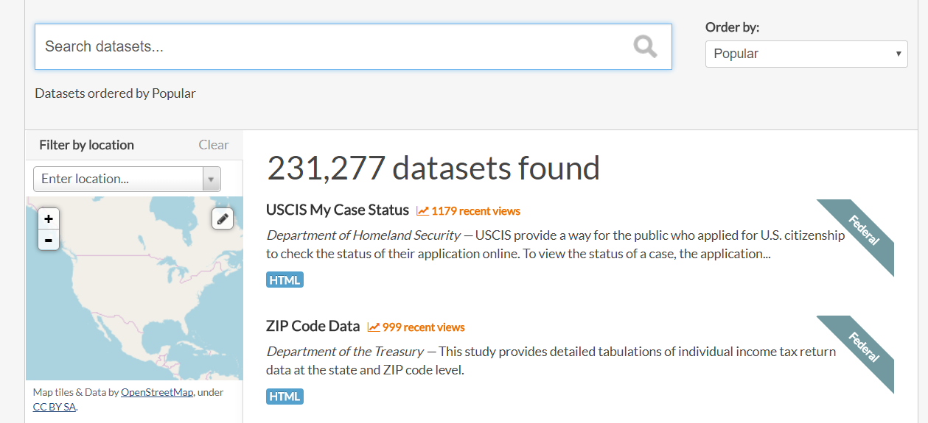
https://catalog.data.gov/

Slide 5
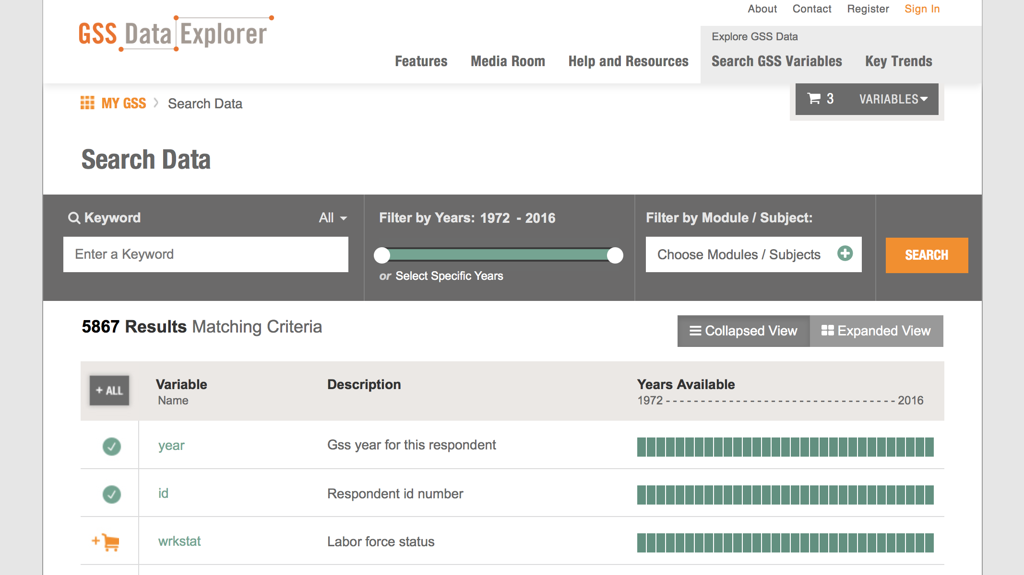
General Social Survey Data Explorer

Slide 6
Data
Source
Social science surveys such as the General Social Survey
Potential sources:
General Social Survey, British Social Attitudes Survey, European Social Survey, etc.
Collection method
Download datasets from official websites and/or scrape survey websites
Allow users to potentially upload their datasets
Expected finishing date for data collection
6th week

Slide 7
What needs to be done and task distribution
Gather data from various sources (Everyone)
Clean data (Bethany)
Build web interface (Ruixue and Leoson)
Topic modeling (Ruixue and Bethany)
Search algorithm (Bethany and Leoson)
End-User Feedback
Notes:
Emphasize computational portion of data search

Slide 8
Potential Issues
Issues with data collection: many large scale surveys are not open to the public
Potential Solutions
Use many smaller surveys/ allow user input
Talk to faculty and survey organizations and ask for permission
Scrape survey data from web
Expand to include other types of datasets
Difficulties with multiple data formats for user input
Potential solution
Create clear guidelines for the format of the data input
Automatically check for compatibility

Slide 9
Questions/Comments?

